Slide 1
DTPM SIG
11/09/2022
Notes:
Meeting minutes are in the speaker notes for the relevant slide

Slide 2
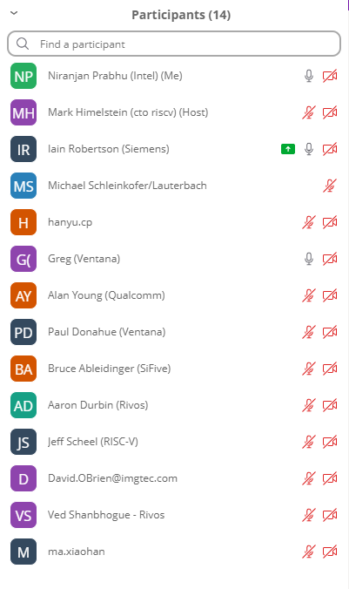
Agenda
Disclosure
Charter - recap
TG Status
Debug, Nexus
Maintenance
eTrace clarification on push/pop and data trace
Gap Analysis
Discussion
Future meetings
AOB
Notes:
Attendees:
Iain Robertson (Siemens, chair)
Niranjan Prabhu (Intel, vice chair)
Mark Himmelstein (RVI CTO)
Michael Scheinkofer (Lauterbach)
Hanyu.cp
Greg (Ventana)
Alan Young (Qualcomm)
Paul Donahue (Ventana)
Bruce Ableidinger (SiFive)
Aaron Durbin (Rivos)
Jeff Scheel (RVI)
David O’Brien (Imagination)
Ved Shanbhogue (Rivos)
Xiaohan Ma (Alibaba)

Slide 3
Disclosures
Video link

Slide 4
Only RISC-V Members May Attend
Non-members are asked to please leave except for Joint Working Groups (JWG).
Members share IP protection by virtue of their common membership agreement. Non-members being present jeopardizes that protection. Joint working groups (JWG) agree that any IP discussed or worked on is fully open source and unencumbered as per the policy.
It is easy to become a member. Check out riscv.org/membership
If you need work done between non-members or or other orgs and RISC-V, please use a joint working group (JWG).
used to allow non-members in SIGs but the SIGs purpose has changed.
Please put your name and company (in parens after your name) as your zoom name. If you are an individual member just use the word “individual” instead of company name.
Non-member guests may present to the group but should only stay for the presentation. Guests should leave for any follow on discussions.

Slide 5
Antitrust Policy Notice
RISC-V International meetings involve participation by industry competitors, and it is the intention of RISC-V International to conduct all its activities in accordance with applicable antitrust and competition laws. It is therefore extremely important that attendees adhere to meeting agendas, and be aware of, and not participate in, any activities that are prohibited under applicable US state, federal or foreign antitrust and competition laws.
Examples of types of actions that are prohibited at RISC-V International meetings and in connection with RISC-V International activities are described in the RISC-V International Regulations Article 7 available here: https://riscv.org/regulations/
If you have questions about these matters, please contact your company counsel.

Slide 6
Collaborative & Welcoming Community
RISC-V is an open ISA enabling a new era of processor innovation through open standard collaboration. Born in academia and research, RISC-V ISA delivers a new level of extensible software and hardware freedom on architecture, paving the way for the next 50 years of computing design and innovation.
We are a transparent, collaborative community where all are welcomed, and all members are encouraged to participate. We are a continuous improvement organization. If you see something that can be improved, please tell us. help@riscv.org
We as members, contributors, and leaders pledge to make participation in our community a harassment-free experience for everyone.
https://riscv.org/community/community-code-of-conduct/

Slide 7
Conventions
For one hour meetings, please start at 5 after the start time in order to allow people going to other meetings have time for a short break between meetings. 30 minute meetings start on time.
Unless it is a scheduled agenda topic, we don’t solve problems or detailed topics in most meetings unless specified in the agenda because we don’t often have enough time to do so and it is more efficient to do so offline and/or in email. We identify items and send folks off to do the work and come back with solutions or proposals.
If some policy, org, extension, etc. can be doing things in a better way, help us make it better. Do not change or not abide by the item unilaterally. Instead let's work together to make it better.
Please conduct meetings that accommodates the virtual and broad geographical nature of our teams. This includes meeting times, repeating questions before you answer, at appropriate times polling attendees, guide people to interact in a way that has attendees taking turns speaking, …
Where appropriate and possible, meeting minutes will be added as speaker notes within the slides for the Agenda

Slide 8
Charter
Full verbiage is here. Key points:
The goal for the DTPM SIG shall be to define a strategy to establish specifications and guidelines for the interfaces, transports, and other pieces of the SoC infrastructure
The DTPM SIG shall focus on the following areas:
Standard programming interface
Standard transports
Unified security architecture
Cables and connectors
Debug, Trace, and SoC performance monitoring features
The DTPM SIG shall work on a gap analysis by starting with a lay of the land review on RVI debug, trace, SoC performance-monitoring capabilities
Notes:
Greg: need to clarify "transports"
Iain: scope is around Trace Transports and we can clarify. Update: the full charter wording already makes this clear
Greg: What is Unified Security Architecture?
Ved: Various debug levels End-User, Expert or OEM, etc.
How do we authorize different levels?
Root of trust being established to debug and identify if debug is enabled on a platform
What can be part of debug vs what cannot be part of debug?
Charter needs to expand further

Slide 9
TG Status - Debug
Should be ready to ratify v1.0 March 2023
Several minor follow-on items deferred to v1.1:
#562, let the debugger flush caches when there is no program buffer
#390, optionally don't reset debug CSRs during reset
Notes:
Greg: Debug spec did not comprehend vector loads and stores
Iain: need to be considered for future
Needs to be considered as a new ask and not block existing work

Slide 10
TG Status - Nexus
Connectors
Most extensions agreed with MIPI
Common control
Reworking to provide dedicates 4k blocks per component
Discussion ongoing regarding access from non-system bus
Nexus Messages
Some clarifications
Reference encoder/decoder
Changed to match messages
Need clarity on what remains to be done
Notes:
Mark: there is Performance Analysis SIG for applications run by Beeman
Iain: will reach out to Beeman
Greg: Are we to merge Nexus proposals or drive them separately
Iain: Need to come up with way to handle all the changes
Greg: Whats the definition of completing the tasks?
Iain: Need to have Robert and have a comprehensive discussion
Greg: Do we expect all Trace information in ADOC?
Iain: need to come up with a document and consolidation process

Slide 11
Maintenance
eTrace: Seagate requested some further clarification on push/pop support for data trace
Examples added to section 4.3 and pull request made
No functional change
Need to determine approval process for updating the spec given that it is ratified.
Notes:
Mark: Maybe have a Update TG to handle new request and TSC will approve it
Iain: Versioning rules??
Jeff: please reach out to help@riscv.org for the versioning rules
Greg: Vector support?
Iain: not supported right now

Slide 12
Gap Analysis
Trace
Common Control
Ongoing, under Nexus TG (for historic reasons). Progress very slow
Connectors
Ongoing, under Nexus
eTrace packet encapsulation for transport
High priority, should be a small task – spin up a TG?
eTrace cycle accurate and vector extension support
Lower priority?
Performance counting
Define standardised architecture, metrics and access for performance counting.
Useful starting point here and here.
Any interest in starting a TG?
Debug Authorisation framework
Remote Telemetry
Alternatives to GDB with multi-core support
Notes:
Mark: If members are not pushing the features and working on it, we wont do it.
Ved: eTrace and Nexus are defined to a trace port, need trace to memory?
Iain: potentially captured in encapsulation item; it is important and need to spin up TG
Ved: may need to consider virtualization
Greg: may not be one encapsulation standard needed?
Iain: there are examples in eTrace, but not complete or normative
Greg: need to have a complete standard for control of trace to memory
Iain: there is a register map in the common control doc, though this may not be sufficient. Need to complete but maybe should not be part of Nexus TG
Xiahoan Ma: What is Trace information? More than instructions?
Iain: Instruction and Data Trace spec have been defined; Maybe there is scope for more?
Ved: Branch tracing is of more interest for SW debug
Greg: Performance SIG from Beeman has started this topic
Maybe need to be coordinated
Ved: remote telemetry - for large machines to be monitored remotely
Ved: Self hosted debug as a gap? Debug to be delegated to lower modes like Supervisor mode
Mark: Competitive analysis of all features from different architectures
Iain/ Niranjan: we do need to analyze

Slide 13
Future Meetings / AOB
Meeting frequency?
In-person meeting at RISC-V summit?
No slots remaining on member day but a slot during the conference days is possible
AOB

Slide 14
Thank You

